Slide 1
Implementation of sentiment analysis on unstructured data
Presented by: Under Guidance of:
Abhinav Anand R110212001 Mr. Ajay Rawat
Deepankar Agrawal R110212022
Mayank Mahajan R110212039

Slide 2
Introduction
Search Worm helps us to upload a number of PDF’s and then using those files helps us to search for a particular topic. For example:
If a person has to study about Threads in Java, then he/she will have to go through various e-books and then search manually in those e-books about the topic – Threads.
This would be costly in terms of:
Time
Effort
Search Worm is the solution to such problems.
The person just needs to upload all the e-books, he/she wants to refer and search for Threads.
OUTPUT: The person gets the possible answers based on the supplied documents with page numbers and headings.

Slide 3
Problem Statement
To refer to a particular topic in the document, we have to go through the entire document and read it thoroughly which is time consuming.
Now consider this time with respect to n number of documents which are to be referred.
Our project solves this problem by indexing the document content and with the help of sentiment analysis, we return the possible answers based on the supplied documents with page numbers and headings (if it is a book).

Slide 4
Objectives
Search worm uses the following steps to make search easy:
Parsing the PDF
Storing the metadata of the book
Indexing the book

Slide 5
Methodology
Explain all the previous points

Slide 6
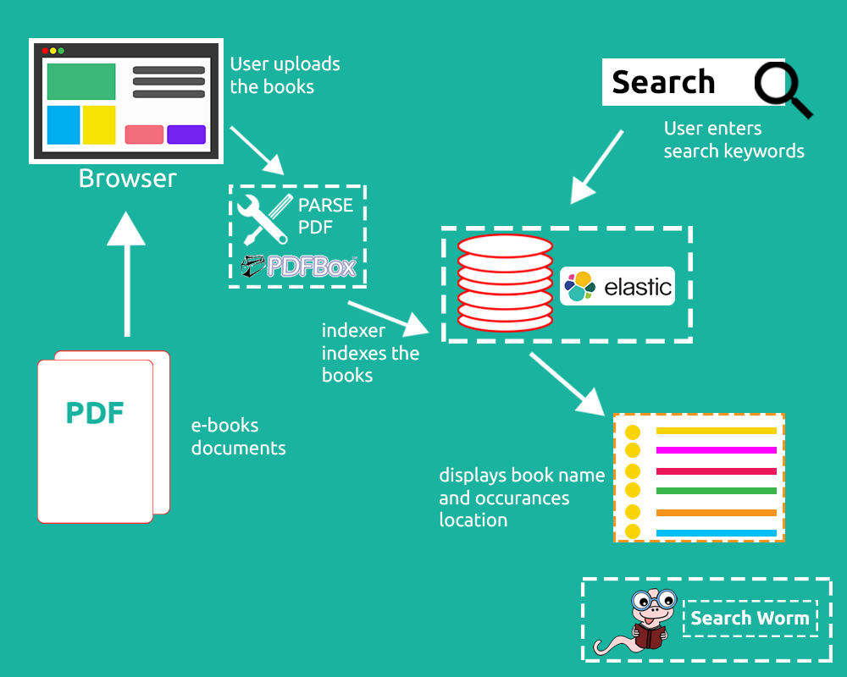
Overall Structure of Search Worm

Slide 7



Technologies used
Content goes here
Backend Technologies

Slide 8

Technologies used
Content goes here
Frontend Technologies

Slide 9
Screenshots

Slide 10
References

